Slide 1
R Course - 2020
Sumeet Pal Singh
YuRa Song

Slide 2
Aim of the course
Foundation course
Independent in data analysis and plotting
Independent: Use open-source software (R)
Independent: Capable of performing the analysis being performed

Slide 3
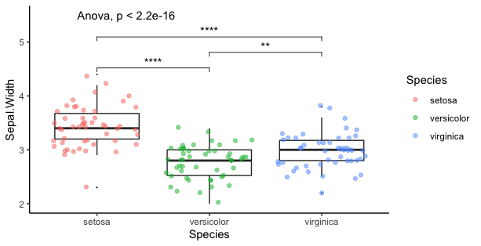
Goal of the course

Slide 4
What is not covered
Bioinformatics
(Planning a follow-up course on bioinformatics)
Algorithm: How to code new problem / new analysis
Multiple methods for achieving same result: We will show you one method to get you started. Further exploration depends on you!

Slide 5
Timeline
Two sessions per week
Each session ~ 1 – 2 hours
5 – 6 sessions
After each session, a practice homework will be assigned (This is the most important part of the course!!)
Homework: 30 – 2 hours
Per week: 3 – 5 hour commitment

Slide 6
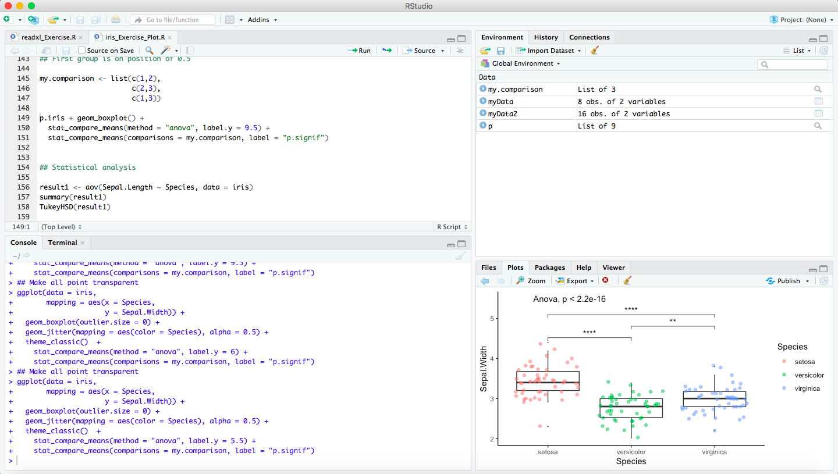
Session 1: Introduction to Rstudio and 1-D data types
Editor (Edit R files)
Environment / History
Console
(Code is executed)
Plot

Slide 7
Vectors
Vector is a collection of scalars (E.g. 4 is a scalar; c(4, 3, 5) is a vector)
Scalar are 0-dimensional. Vectors are 1-D.
Four major types of vectors
Numerical: c(4, 3, 5)
Character: c(“A”, “B”, “C”) (Character scalar is called a “string”)
Factor (Grouping): factor(”Red”, “Red”, “Blue”, “Red”, “Blue”)
Logical: TRUE, FALSE, TRUE, TRUE, FALSE

Slide 8
Function
Used to perform a specific operation.
Input (Arguments) -> function -> output
output <- name(arguments)
mode, length, log(), sqrt()

Slide 9
Subsetting
Select or extract values
Use square brackets: []
Subsetting can be positional / condition (by name)

Slide 10
Summary
Vectors are a collection of scalars
They can be of four types:
Numeric
Character
Factor
Logical
To subset a vector, use []

Slide 11

Package
To install: install.package(“package_name”)
To use: library(package)
To learn more about: vignette(“package”)

Slide 12
Sessions
Introduction (Rstudio and Data types)
Data frame and dplyr (and statistics)
Reading a file and Wide to long conversion
Plotting the data

